Slide 1
Angular Routing
Routing Basics
Lecture 1
By James(Jin) Wang
12/26/2021

Slide 2
Outline
Setting up Basic Routing
HTML5 vs Hash-based Urls

Slide 3
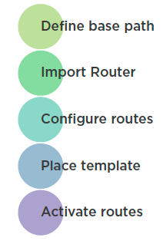
Setting up Routing
  Setting up Routing

Slide 4
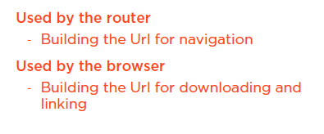
Setting up Routing
  Defining the Base Path

Slide 5
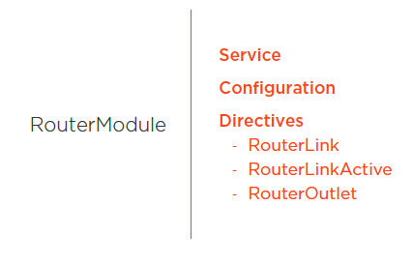
Setting up Routing
  Importing the Angular Router

Slide 6
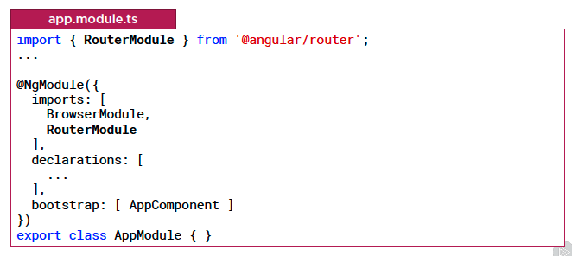
Setting up Routing
  Importing the Angular Router

Slide 7
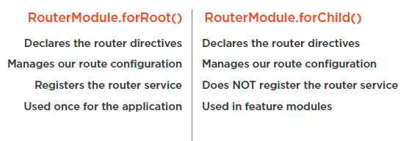
Setting up Routing
  Importing the Angular Router

Slide 8
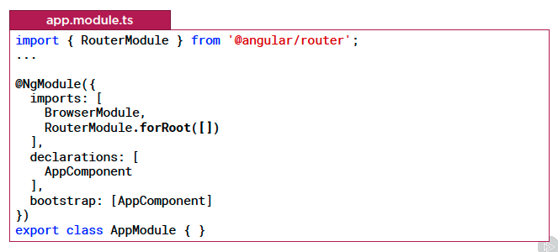
Setting up Routing
  Importing the Angular Router

Slide 9
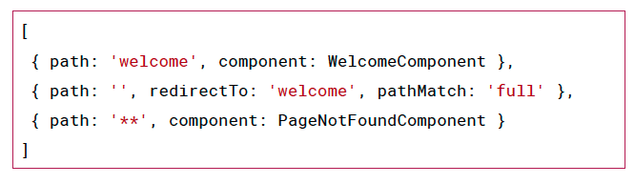
Setting up Routing
  Configuring Routes

Slide 10
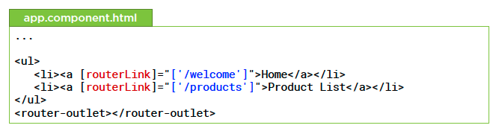
Setting up Routing
  Placing the Templates

Slide 11
Summary

Slide 12
Assignment

Slide 13
Self Study
  Angular HTTP Communication
  https://app.pluralsight.com/library/courses/angular-http-communication

